Slide 1
UNIT 3 SERVER TECHNOLOGY

Slide 2
Server Technology
Operating System
Virtualization Hypervisor
Server Deployment , Server Availability concepts and techniques
Server workloads server directory concept
Overview of LDAP, LDAP Architecture
LDAP Models, LDAP Replication Topologies, LDAP Data Interchange Format.

Slide 3
SERVER TECHNOLOGY
What is Server Technology? – Provides resources to other computers in the network
– Hardware vary depends upon the application
• Types of Services
– File Server
– Print Server
– Database Server

Slide 4
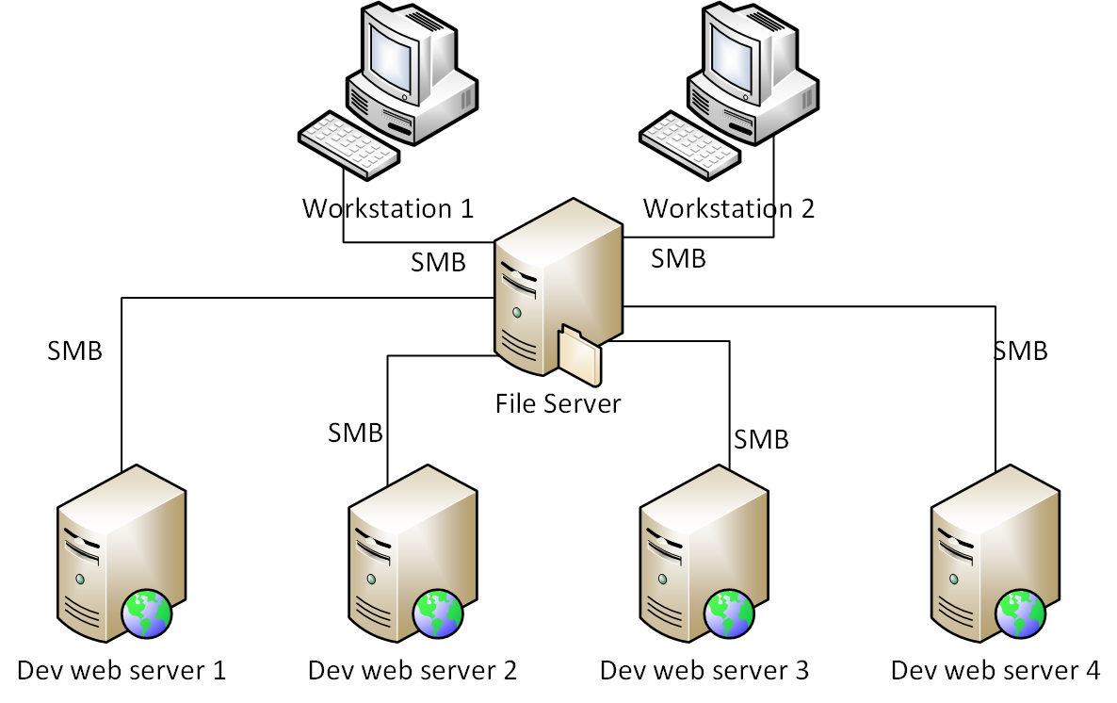
File Server

Slide 5
In the client/server model, a file server is a computer responsible for the central storage and management of data files so that other computers on the same network can access the files.
A file server allows users to share information over a network without having to physically transfer files by floppy diskette or some other external storage device. Any computer can be configured to be a host and act as a file server.
A file server may be an ordinary PC that handles requests for files and sends them over the network. In a more sophisticated network, a file server might be a dedicated network-attached storage (NAS) device that also serves as a remote hard disk drive for other computers, allowing anyone on the network to store files on it as if to their own hard drive.

Slide 6
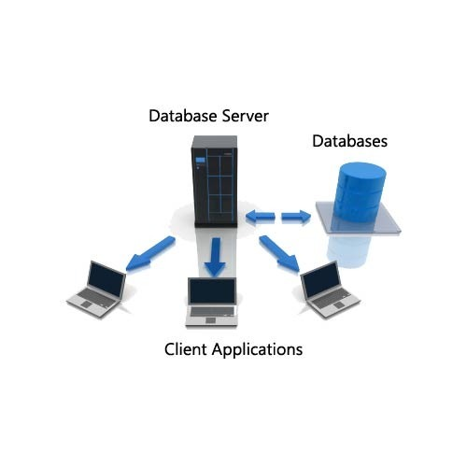
Database Server
A database server is a server which houses a databaseapplication that provides database services to other computer programs or to computers, as defined by the client–server model. ... The SQL (Structured Query Language) query language is more or less the same on all relationaldatabase applications.

Slide 7
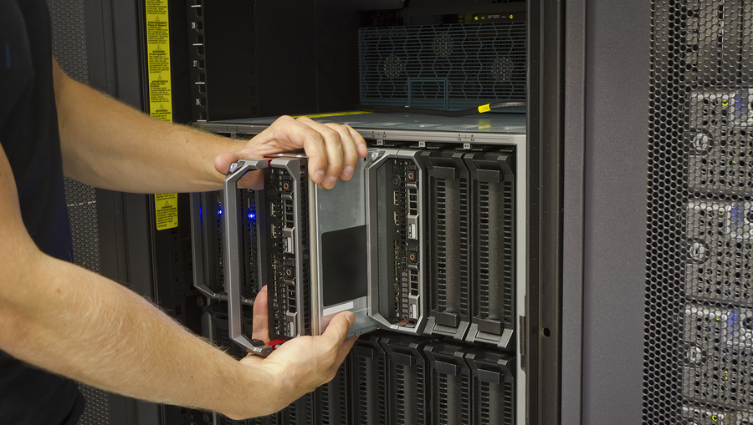
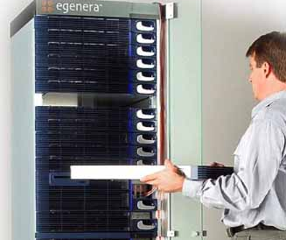
Blade Server
Single circuit board
– Added with hardware component
– Uses laptop technology
– Individual blade connected using system bus
Common power supply and cooling
– Less power consumption
– Separate Operating system in each blade
– Separate System Applications in each blade
– Blade Servers are Hot swappable

Slide 8
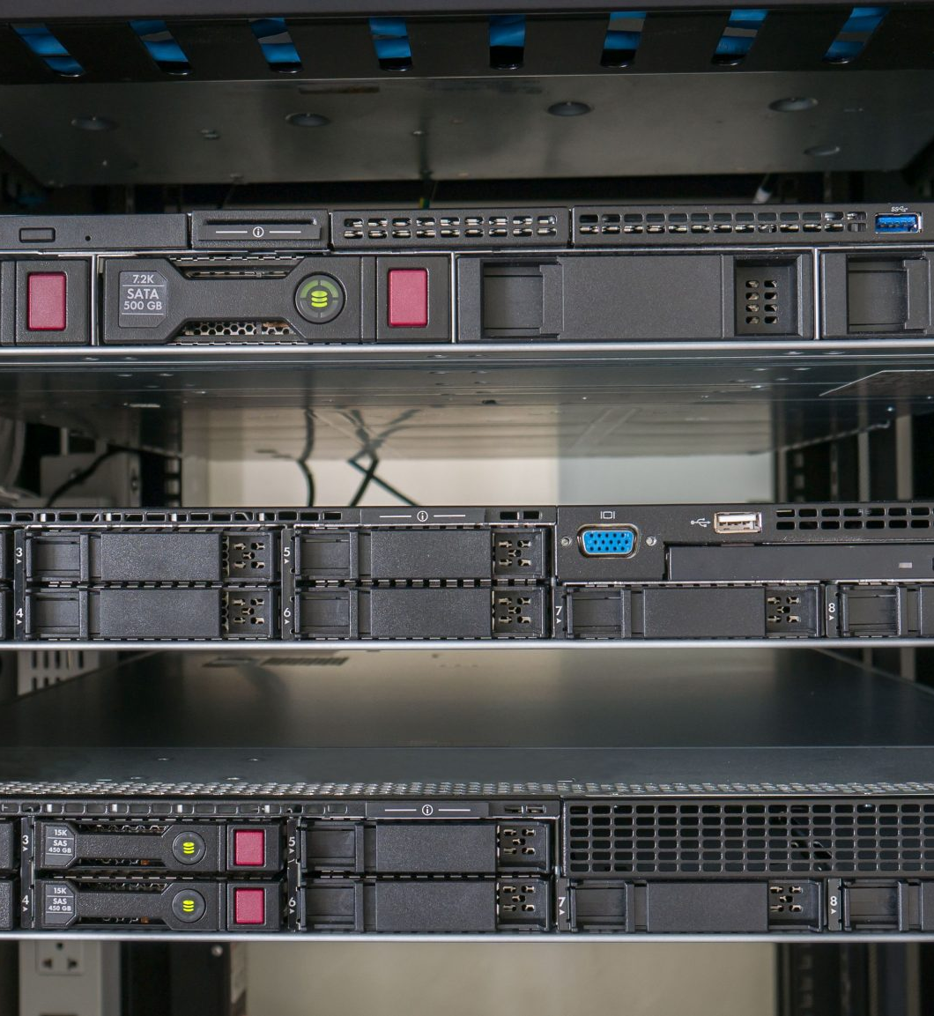
Rack Server
Reduce floor space
– Multiple Mounting slots and bays
– Separate power for each server
– Common cooling system
– Servers in different sizes

Slide 9
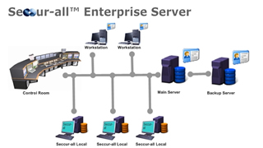
Enterprise Server
– Computer that has programs collectively to server
– Mainframe computer systems
– Unix and Wintel Servers

Slide 10
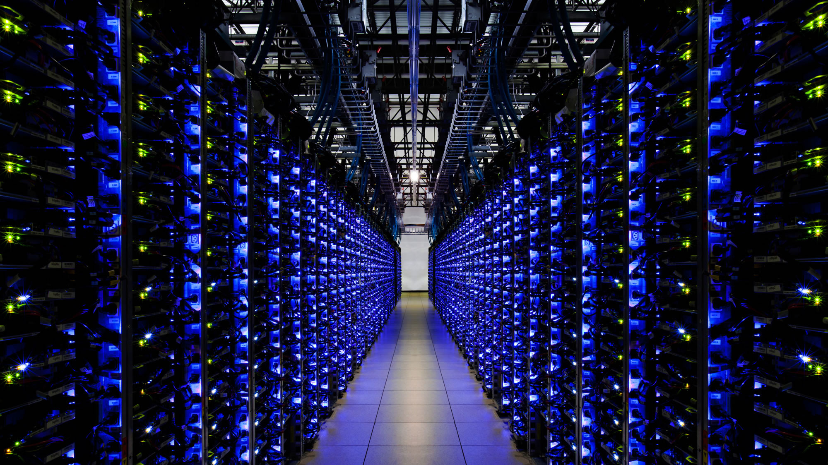
High Performance Server
– Most powerful and flexible research system
– Used for climatology, quantum chemistry
– HPC cluster disrupted supercomputing

Slide 11
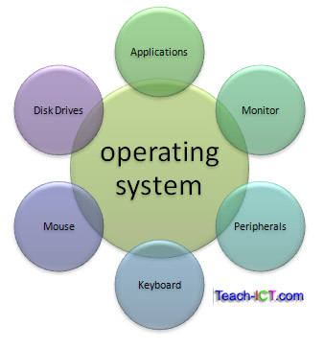
Operating System
Operating System is the collection of software to manage computer hardware resources and to provide common services for computer programs.
– Operating System is the essential component of the system software in a computer system.
– Operating system is required for the functioning of the application programs.

Slide 12
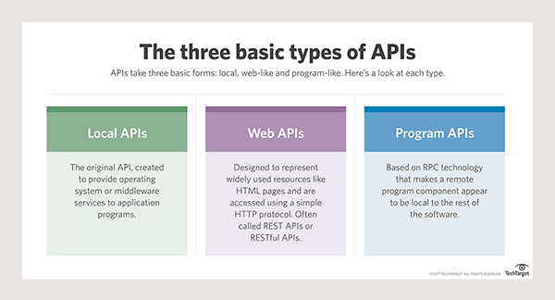
Operating System
Operating system also provides a consistent application interface which is required if more than one type of computer uses the operating system.
The Application Program Interface (API) allows a developer to write an application on a particular computer and the same can be run on another computer having different amount of memory or quantity of storage.

Slide 13
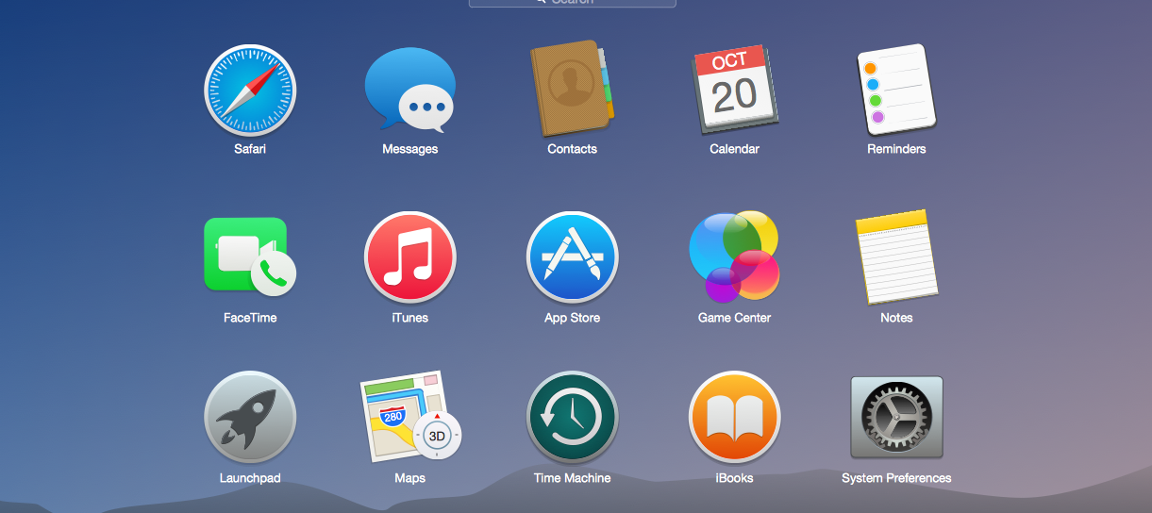
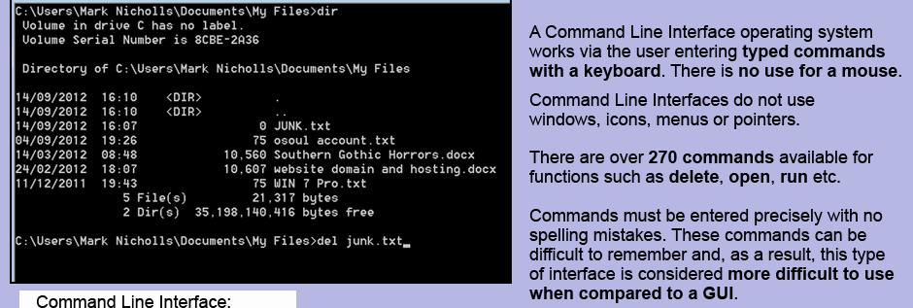
Operating System
The users interact with the operating system through a set of commands.
– The command processor or command line interpreter in the operating system accepts and executes the commands.
– The graphical user interfaces allows the users to enter commands by pointing and clicking at objects on the screen.

Slide 14
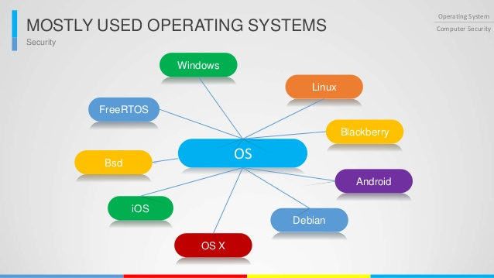
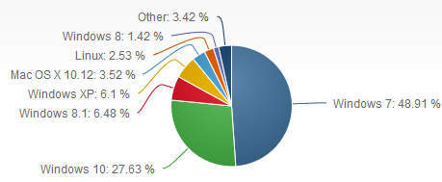
OS Market Share

Slide 15
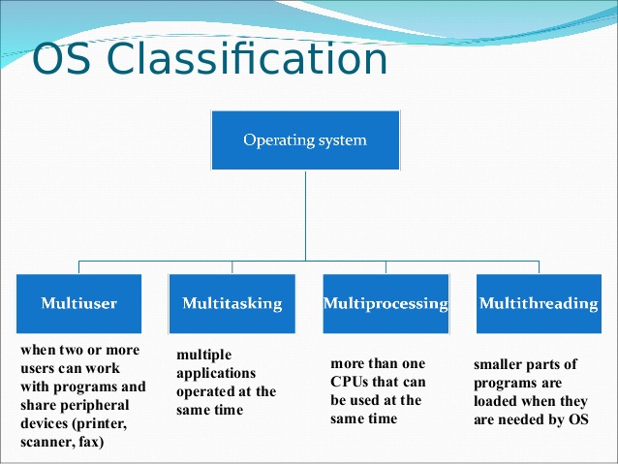
Classification of Operating System
Real-time operating system: Real-time operating system is one which is used to control machineries, scientific instruments and industrial systems. RTOS has minimal user-interface capabilities and has no end user interfaces.
Multi-User: Multi-User operating system is one which allows two or more users to run programs at the same time.
Multiprocessing: Multiprocessing is an operating system which supports running a program on more than one CPU.

Slide 16
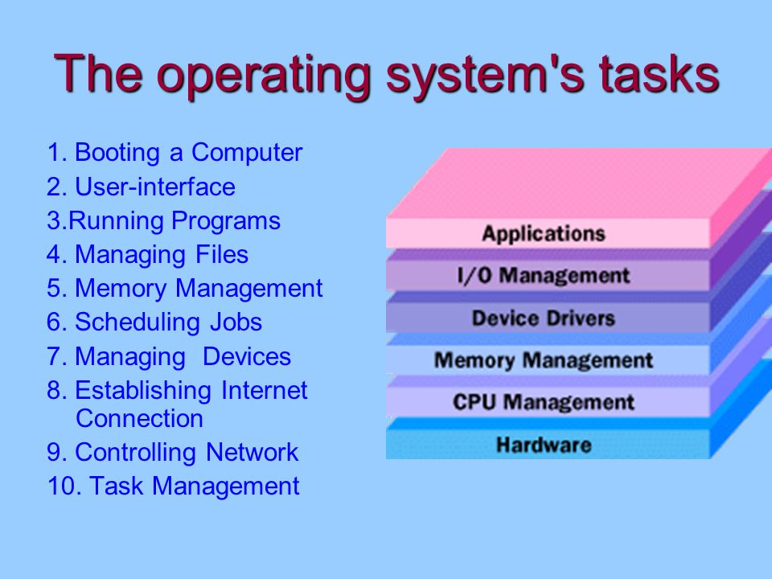
Classification of OS and Task of OS
Multitasking: Multitasking is an operating system which allows more than one program to run concurrently.
– Multithreading: Multithreading is an operating system which allows different parts of a single program to run concurrently.
– Real time: Real time is an operating system which responds to the input instantly.
Process Management
– Memory Management
– Device Management
– File Management

Slide 17
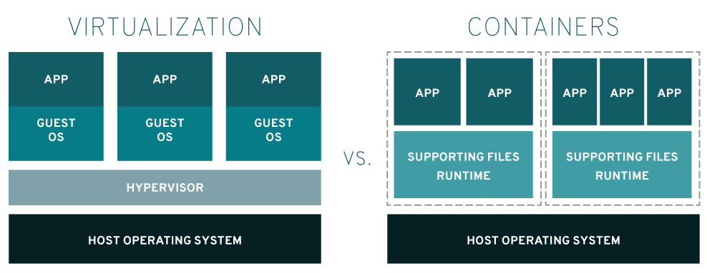
What is Virtualization?
– The technique of splitting one physical resource into multiple virtual resources is called as virtualization.
– A single physical resource can be used for multiple purposes and to perform the required actions.
– Virtualization or system virtualization is the creation of many virtual systems with a single physical system

Slide 18
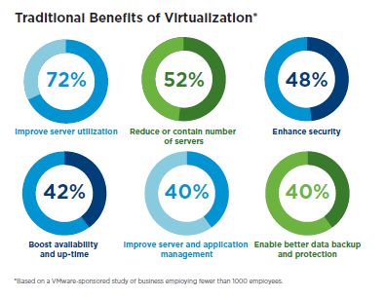
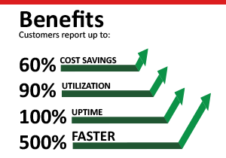
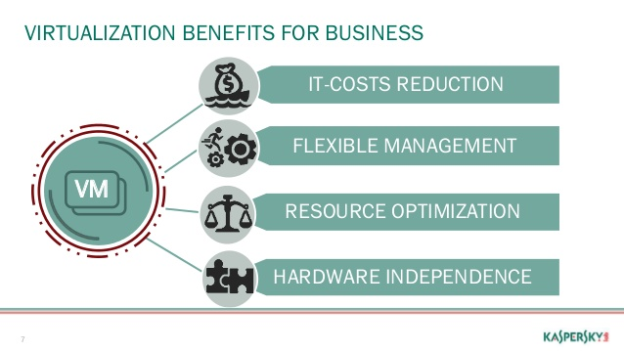
Benefits of Virtualization
– Reduces hardware cost as a single server acts as multiple server.
– Workload is optimized by dynamically sharing the resources.
– Gives a single consolidated access to all the available resources for IT responsiveness and flexibility.

Slide 19
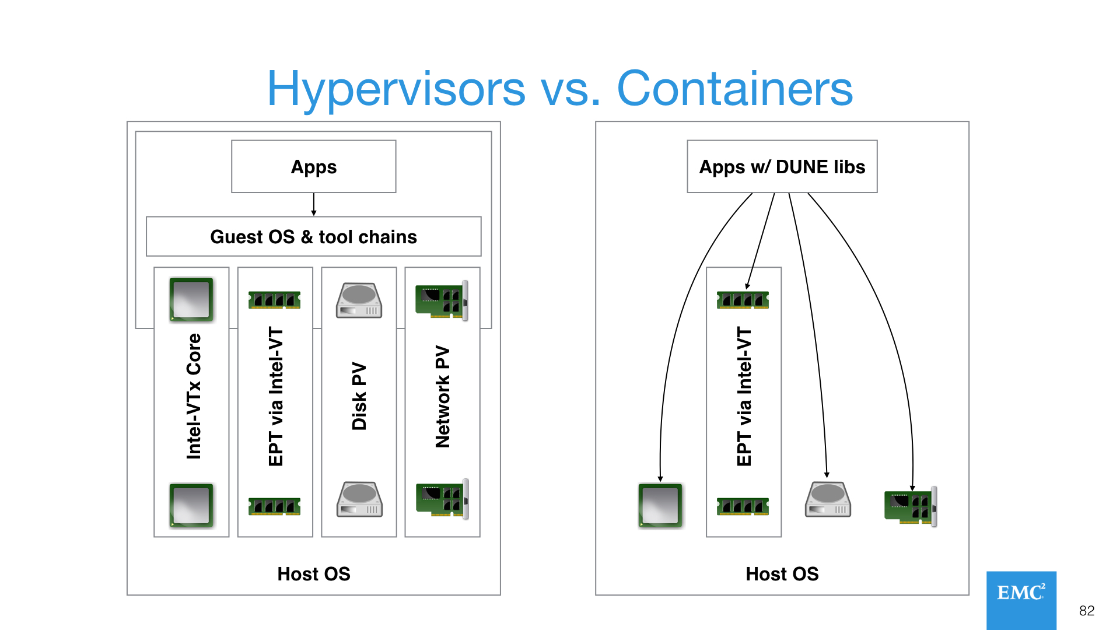
Hypervisor
– A technology allowing multiple operating systems to run on a single hardware at the same time, who’s hardware is virtualized.
– This process is called as virtual machine manager.

Slide 20
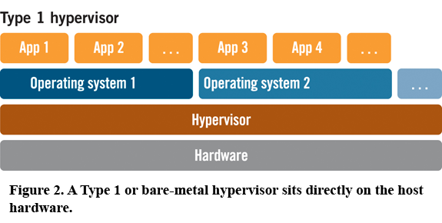
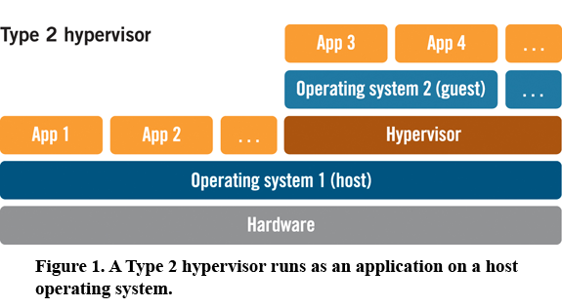
Types of Hypervisor
The two types of Hypervisor are Type 1 and Type 2
Type 1 hypervisor runs directly on the physical hardware, without out intermediate operating system. This is also called as “bare metal hypervisors”.
Type 2 hypervisor runs over the operating system using virtual PC or virtual box. There are two layers, the operating system and the hypervisor between each virtual machine.

Slide 21
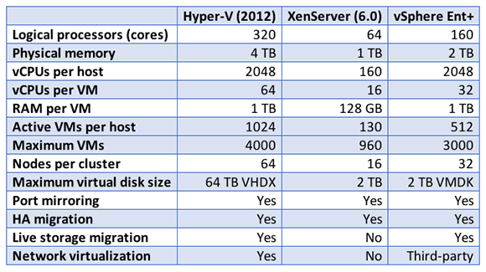
Features of hypervisor
Features of Hypervisor Operating system and workload can be consolidated into one server, reducing the cost of operations and hardware.
Multiple operating systems can be run on a single hardware at the same time, each running applications as per requirements.
Dynamically assigning of resources is possible from virtual resource to the physical resource through methods like dispatching and paging.
Workload is managed with ease in a single server to improve the performance, system use and price.

Slide 22
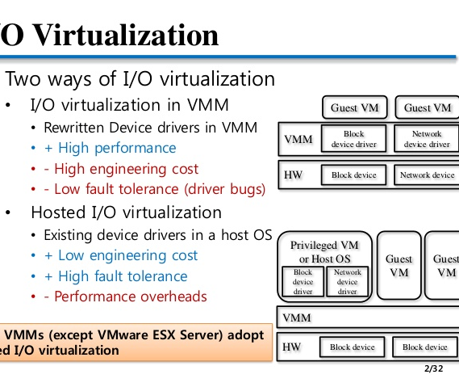
I/O Virtualization
Virtualizing the I/O from the server to peripherals is called I/O virtualization.
The devices are connected within the server using interfaces or adapter.
The adapters are moved into a switching box and can be shared across different physical servers, reducing the server space after it is moved out. Many servers can be accommodated in a single rack.
Using I/O virtualization the SAN and network connections are consolidated to a single High Speed cable.

Slide 24
Virtual Machines
Virtual machine is a software which emulates a physical computing environment, over which operating system and programs can be installed.
The VM are generally created within the virtualization layer like hypervisor, which runs over the operating system.
The operating systems running in the virtual environment are not aware of the virtual platform.

Slide 25
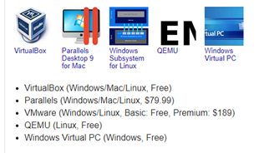
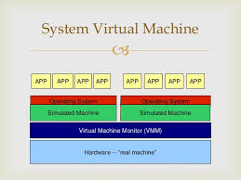
Virtual Machine Types
Virtual Machine is classified into two types
System Virtual Machine:
– The existing architecture is emulated to suite the purpose of running the program where the real hardware is not available.
– System Virtual Machine is also called as hardware virtualization.

Slide 26
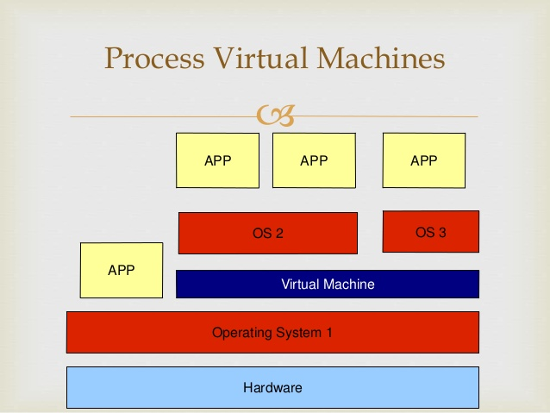
Process Virtual Machine:
– This provides the environment which is platform independent, irrespective of the hardware and the operating system.
– Process Virtual Machine is also called as application virtual machine or MRE (Managed Runtime Environment).

Slide 27
Partitioning
– Partitioning physically divides the server into several smaller servers with dedicated resources.
– Partitioning was originally implemented by IBM.
– Partitioning gives the ability to dedicate a physical computer to a virtual machine.

Slide 28
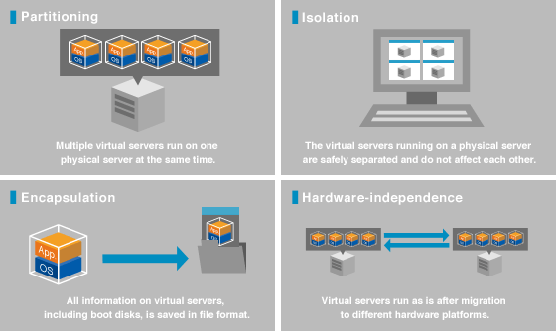

Slide 29
Server Deployment
– Server Deployment is a technology for network based installation of the operating system.
– The operating system deployment is necessary for –Provisioning the OS for desktops for new employees
–Redeploying the operating system of corrupt systems for troubleshooting
– Periodically redeploying the OS

Slide 30
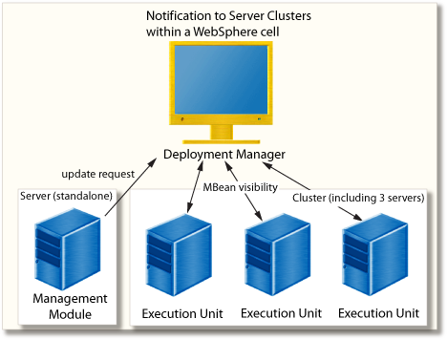

Slide 31
Features of deploying the operating system
– Manual Deployment: The operating system is deployed using the image that is created. The deployment configurations is set in the deployment templates.
– Event-Driven Deployment: Event-Driven deployment is suitable in cases where the operating system needs to be deployed to multiple systems simultaneously by controlling the bandwidth during the deployment process.
Scheduled Deployment: Scheduled Deployment is where the OS is deployed to multiple systems for which the MAC address is known.
– Custom Deployment: In the Custom Deployment process, the administrator creates a set of deployment template meeting the organization needs and assigns a name to each template and the user initiates the deployment.
– Standalone Deployment: Standalone Deployment is a process of deployment on computers that are not a part of the network.

Slide 32
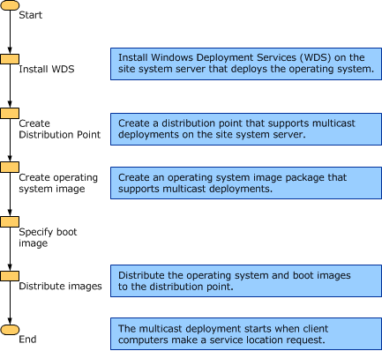

Slide 33
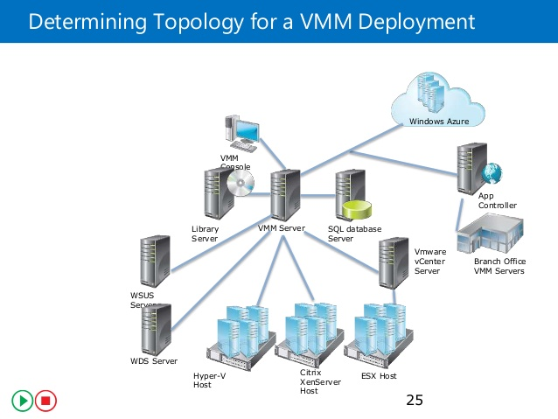
Server Deployment
Virtual Server Deployment
The steps in deploying the Virtual Server
–Installing IIS
–Installing Virtual Server
–Adding a virtual machine
–Adding guest operating system

Slide 34
Server Management Console
– Server Management Console is provides centralized administration and management of processes in distributed networks.
– The server management console is used to view and manage virtually all the features and tools affecting the server productivity.
– The server management console is a one stop management console for checking the overall health of all the server roles and features in the server.

Slide 35
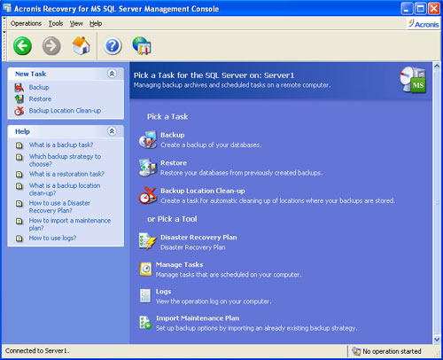

Slide 36
The Server Management Console is used for the following administrative tasks
Viewing and Modifying the server roles and features installed on the server.
Starting and stopping the services to perform the management tasks.
Identifying critical events, determining the server status and to analyze and troubleshoot configuration failures

Slide 38
Server Availability Concepts and Techniques
– Server Availability is defined as a level of service provided by applications, services and systems.
– Highly available systems will have minimum downtime.
– Various operating systems offer clustering, advanced fault tolerance and file system recoverability features for high availability.

Slide 39
Server Availability Concepts and Techniques
– Server Clusters: Server Cluster is a feature which provides high availability, scalability and manageability for various applications and resources.
– Network Load Balancing: Network Load Balancing improves the scalability and availability of internet server programs. The basic function of NLB is to provide high availability for web server programs and also to scale up the server performance.
– High performance computing: High performance computing clusters spreads the computational tasks among multiple nodes.

Slide 40
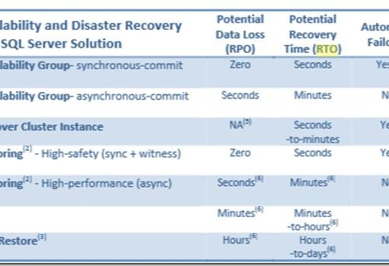
– Server Clusters: Server Cluster is a feature which provides high availability, scalability and manageability for various applications and resources.
– Network Load Balancing: Network Load Balancing improves the scalability and availability of internet server programs. The basic function of NLB is to provide high availability for web server programs and also to scale up the server performance.
– High performance computing: High performance computing clusters spreads the computational tasks among multiple nodes.

Slide 41
Scheduled and Unscheduled downtime
Scheduled downtime is a result of logical or a management initiated event. The downtime events include patches to the operating system that requires a reboot for the configuration changes to take effect.
Unscheduled downtime is an event which typically arises from any physical event such as a hardware or software failure. Unscheduled downtime happens due to power outages, failed CPU, over temperature related shutdowns.

Slide 43
The requirements for components to be made highly available are
– Reliable basic hardware
– Software quality
– System management tools
– Support and maintenance services

Slide 44
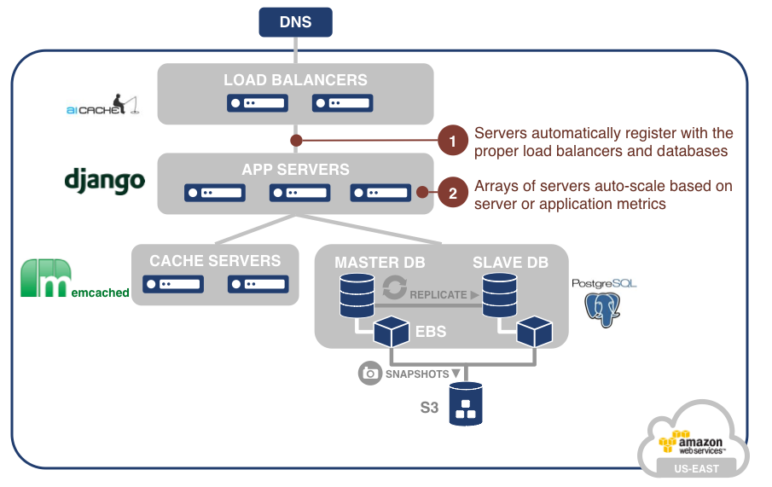
Server Workloads
– Response time is the time between the user request and the response to the request.
– Throughput is the amount of work that is accomplished over a period of time.
– The amount of work handled by the server estimates the efficiency and performance of that particular server. Servers and various components like database systems are often assigned a workload upon its creation.

Slide 45
Various server workloads are
– Memory Workload
– CPU Workload
– I/O Workload
– Database Workload

